Slide 1
Informed Search
Chapter 3

Slide 2
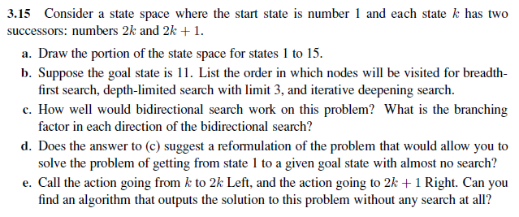
Notes:
a.
1
+--------+--------+
2 3
+---+---+ +---+---+
4 5 6 7
+-+-+ +-+-+ +-+-+ +-+-+
8 9 10 11 12 13 14 15
B.
BFS: 1, 2, 3, 4, 5, 6, 7, 8, 9, 10, 11
DFS: 1, 2, 4, 8, 9, 5, 10, 11 assuming we stop at the limit of the drawn portion, otherwise, we will go through 1,2,4,8,16,32,... and so on forever.
Depth Limited with limit 3: same as DFS if we stop at the limit of the drawn portion.
Iterative Deepening: 1, 1,2,3, 1,2,4,5,3,6,7, 1,2,4,8,9,5,10,11
C. It will work well since the branching factor in the backward direction is only 1 (compared to 2 in the forward direction). So the backward search will quickly reach a state visited by the forward search. Overall, this will decrease the search complexity from O(b^d) for BFS to O(b^(d/2)) for Bidrectional search where b is the branching factor and d is the goal depth.
D.
Initial state: n
Goal Test: state = 1
Action: Go to parent
Transition model: new_state = floor(state / 2)
Cost: Doesn’t matter so let it be 1
The branching factor now is 1 and no search is needed.
C.
solution = []
while state != 1:
solution.insert(0, “Left” if state%2==0 else “Right”)
solution //= 2

Slide 3
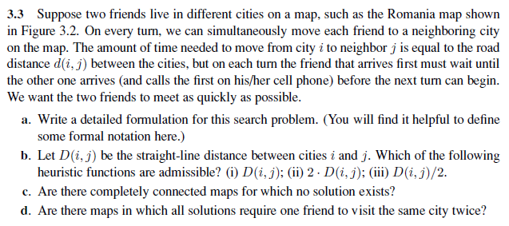
Notes:
a.
State space: States are all possible city pairs (i, j). The map is not the state space.
Initial State: (i, j)
Goal: Be at (i, i) for some i.
Action: {Go((i,j) → (x,y)) where x ∈ neighbors(i) and y ∈ neighbors(j)}
Transition Model: if State=(i, j) and action=Go((i,j) → (x,y)), then the successor is (x, y).
Step cost function: The cost of Go((i,j) → (x,y)) is max(d(i, x), d(j, y)).
b. In the best case, the friends head straight for each other in steps of equal size, reducing their separation by twice the time cost on each step. Hence (iii) is admissible.
c. Yes: e.g., a map with two nodes connected by one link. The two friends will swap places forever. The same will happen on any chain if they start an odd number of steps apart. (One can see this best on the graph that represents the state space, which has two disjoint sets of nodes.) The same even holds for a grid of any size or shape, because every move changes the Manhattan distance between the two friends by 0 or 2.
d. Yes: take any of the unsolvable maps from part (c) and add a self-loop to any one of the nodes. If the friends start an odd number of steps apart, a move in which one of the friends takes the self-loop changes the distance by 1, rendering the problem solvable. If the self-loop is not taken, the argument from (c) applies and no solution is possible.

Slide 4
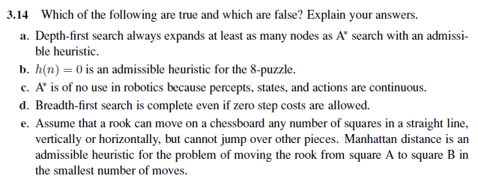
Notes:
False: a lucky DFS might expand exactly d nodes to reach the goal. A∗ largely dominates any graph-search algorithm that is guaranteed to find optimal solutions.
True: h(n) = 0 is always an admissible heuristic, since costs are nonnegative.
False: A* search is often used in robotics; the space can be discretized or skeletonized.
True: depth of the solution matters for breadth-first search, not cost.
False: a rook can move across the board in move one, although the Manhattan distance from start to finish is 8.

Slide 5
Notes:
A heuristic h is consistent if for any transition (S, A) →S_{n}, h(S) - h(S_{n}) ≤ Cost(A, S)
Where S_{n} is the state after we do the action A in state S.
So if the path from any state S₀ to S_{g} (a goal state) is the action sequence [A₀, A₁, … A_{n}], then
h(S₀) - h(S₁) ≤ Cost(A₀, S₀)
h(S₁) - h(S₂) ≤ Cost(A₂, S₂)
And so on till we reach
h(S_{n}) - h(S_{g}) ≤ Cost(A_{n}, S_{n})
And by summing all these inequalities, we get:
h(S₀) - h(S_{g}) ≤ Cost(A₀, S₀) + Cost(A₁, S₁) + … + Cost(A_{n}, S_{n}) = PathCost(S₀, S_{g})
Since h(S_{g}) = 0 (the heuristic estimate at the goal is 0)
So h(S₀) ≤ PathCost(S₀, S_{g})
So if h is consistent, it is admissible (never overestimates the cost to reach the goal).

Slide 6
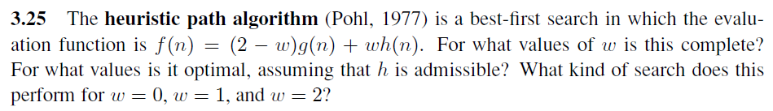
Notes:
It is complete whenever 0 ≤ w < 2. w = 0 gives f(n) = 2g(n). This behaves exactly like uniform-cost search—the factor of two makes no difference in the ordering of the nodes.
w = 1 gives A∗ search.
w = 2 gives f(n) = 2h(n), i.e., greedy best-first search.
We also have f(n) = (2 − w)[g(n) + w/(2 − w)*h(n)] which behaves exactly like A∗ search with a heuristic w/(2−w)*h(n).
For w ≤ 1, this is always less than h(n) and hence admissible, provided h(n) is itself admissible.

Slide 7
Notes:
2 1 4
S -> B -> A -> G
| ^
| 4 |
+---------+
h(S)=7, h(B)=5, h(A)=1, h(G)=0
Shortest path: S->B->A->G (Path cost = 7)
A* Tracing:
Q=[S (f=7+0)] => Explore S to get A & B and add to closed set
Q=[A (f=1+4), B (f=5+2)] => Explore A to get G and add to closed set
Q=[B (f=5+2), G (f=0+8)] => Explore B to get A and add to closed set. Since A is already in closed set, it will not be added to the queue.
Q=[G (f=0+8)] => Dequeue G and traceback the path to S => Path = S->A->G
Result: S->A->G (Path cost = 8) Suboptimal

Slide 8
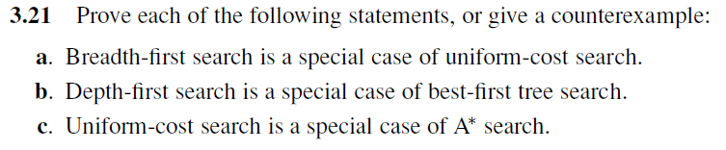
Notes:
When all step costs are equal, g(n) ∝ depth(n), so uniform-cost search reproduces breadth-first search.
Depth-first search is best-first search with h(n) = −depth(n) or 1/depth(n). (Extra: Similarly, Breadth-first search is best-first search with h(n) = depth(n)).
Uniform-cost search is A∗ search with h(n) = 0.

